Slide 1

Minimum Enclosing Ball for Anomaly Detection using Frank Wolfe Variants
Project by :
Dejan Dichoski
Marija Cveevska
Suleyman Erim
Mentor :
Prof. F. Rinaldi
University of Padova

Slide 2
introduction
Minimum enclosing balls (MEBs) provide a very versatile data representation for a wide range of learning and analysis tasks. Use cases include accelerated training of support vector machines or other classifiers, analysis of data streams, and the use case that is the topic of our project - anomaly detection.
While there exists a whole spectrum of algorithms for estimating the MEB of a given data set, a particularly general approach is to formalize the problem in terms of constrained quadratic optimization and we, too, will adhere to this strategy.
We will adapt three algorithms with the goal of solving MEB problem and we will test them on artificial and real-world datasets for detecting anomalies. Finally, we will compare our results.

Slide 3
The primal meb problem
UNIQUE
Only product specifically dedicated to this niche market
FIRST TO MARKET
First beautifully designed product that's both stylish and functional
TESTED
Conducted testing with college students in the area
AUTHENTIC
Designed with the help and input of experts in the field

Slide 4
The dual meb problem
COMPETITORS
Company A Product is more expensive
Companies B & C Product is expensive and inconvenient to use
Companies D & E Product is affordable, but inconvenient to use

Slide 5
Frank wolfe algorithm for meb
$3 Billion
$1 Billion
$2 Billion
Freedom to invent
Selectively inclusive market
Serviceable available market
Opportunity to build
Fully inclusive market
Total addressable market
Few competitors
Specifically targeted market
Serviceable obtainable market

Slide 6
algorithms
Frank wolfe
Few, if any, products on the market help customers like we do
Away steps fw
66% of US consumers spend money on multiple products that only partially resolves their issue
Blended pairwise conditional gradient
Millennials account for about a quarter of the $48 billion spent on other products in 2018
(1+ epsilon) approximation of meb
Loss of productivity costing consumers thousands of dollars

Slide 7
implementation
We implement our algorithms and data generation using Python 3.10. Python is a high-level procedural programming language which is commonly used in data science and mathematics for its low barrier to entry, wide-scale adoption, and rich package ecosystem. One drawback of using Python is that it is known to be slow compared to other languages.

Slide 8
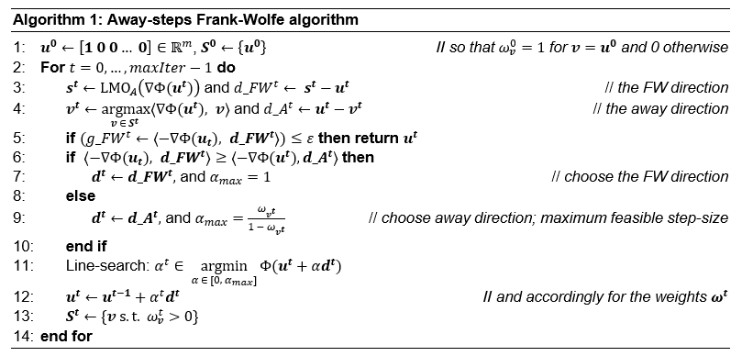
Away steps frank wolfe

Slide 9
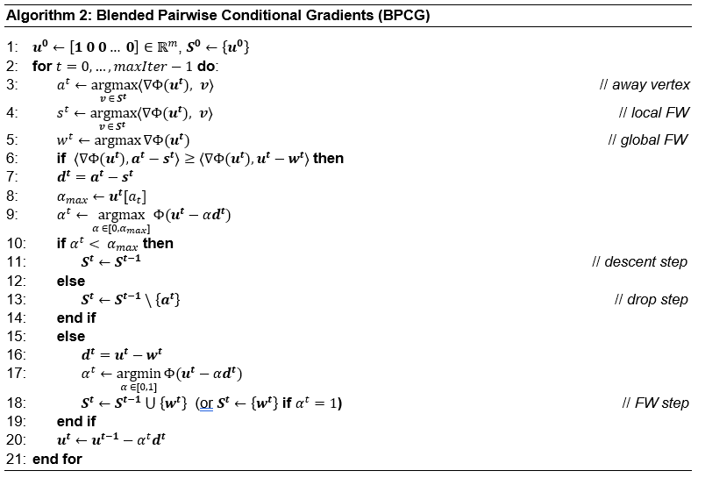
Blended pairwise conditional gradient

Slide 10
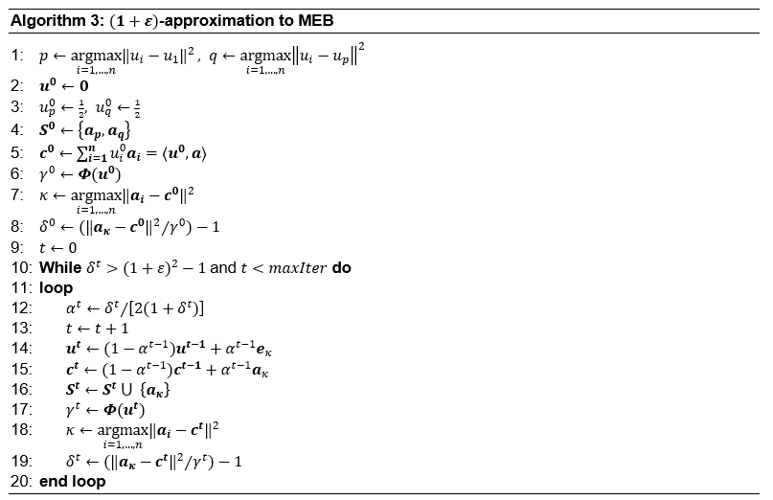
(1+ epsilon) approximation of meb

Slide 11
Line search strategies
Inverse time decay
Initial strategy, satisfactory radius and center parameters, but didn’t converge
Golden section search
Good results with Algorithm 1, but didn’t converge with Algorithm 2.
Armijo’s rule
Even though the obtained results for the center and radius were close to the optimal ones, it was evident that this line search strategy is very slow, and often failed to converge.
Exact line search
Good results, fast convergence for the three Algorithms.

Slide 12
EXPERIMENTS
The experiments aim to assess the quality of our three algorithms on both synthetic and real-world datasets.
The experimental section consists of two parts:
Training and testing the algorithms on synthetic datasets.
Training and testing the algorithms on real-world datasets, also incorporating epsilon (ε) as a variable hyperparameter.
data
GENERATED DATA
REALWORLD DATASETS
Uniform Distributed Data
Gaussian Distributed Data
Breast Cancer Wisconsin Dataset
Customer Churn Dataset

Slide 13
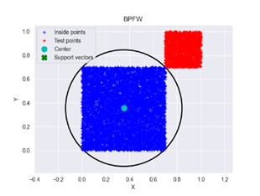
EXPERIMENT UNIFORM DATASET
 | TRAIN |  |  |  | TEST
 | ITTERATIONS | CPU TIMES (S) | RADIUS | ACTIVE SET SIZE | RECALL (%) | F1 SCORE (%)
ASFW | 379 | 23.632 | 1.019375 | 15 | 100 | 100
BPCD | 272 | 16.606 | 1.019365 | 14 | 100 | 100
APPFW | 747 | 22.108 | 1.019697 | 18 | 100 | 100
We created two closely spaced yet separable clusters:
- one for training with 8000 data points sampled from U[0.0, 0.7), and
- one for testing (containing anomalies) with 2000 points sampled from U[0.7, 1.0).
The blue cluster represents nominal points, while the red one represents anomaly points. The circle shows the MEB constructed by Algorithm 2

Slide 14
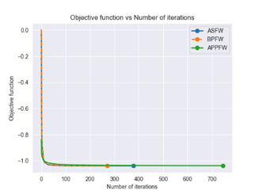
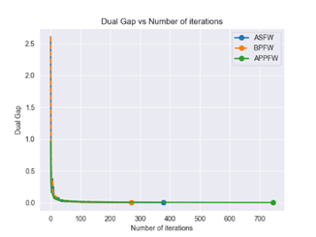
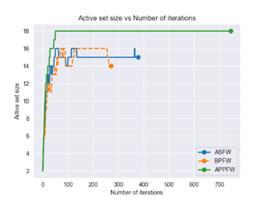
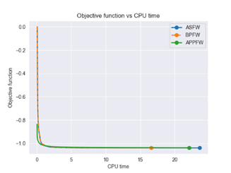
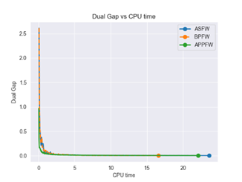
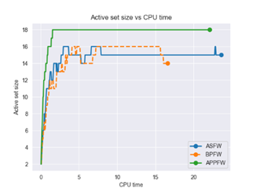
interpretation uniform dataset

Slide 15
Experiment gaussian dataset

Slide 16
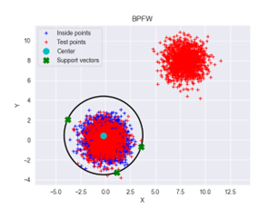
EXPERIMENT GAUSSIAN DATASET
 | TRAIN |  |  |  | TEST
 | ITTERATIONS | CPU TIMES (S) | RADIUS | ACTIVE SET SIZE | RECALL (%) | F1 SCORE (%)
ASFW | 177 | 9.614 | 5.45032 | 9 | 100 | 99.85
BPCD | 130 | 7.219 | 5.45032 | 9 | 100 | 99.85
APPFW | 733 | 21.904 | 5.45191 | 12 | 100 | 99.85
The blue cluster represents training points, while the red one represents test points. The circle shows the MEB constructed by Algorithm 2.
Support vectors are training points that lie on the boundary (MEB). The red points around the center of the MEB are test points belonging to the nominal class, while the red cluster on the top right represents the anomaly points in the test set.

Slide 17
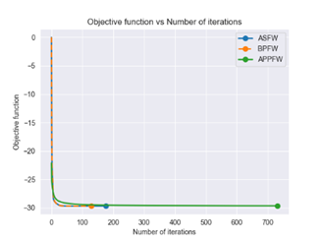
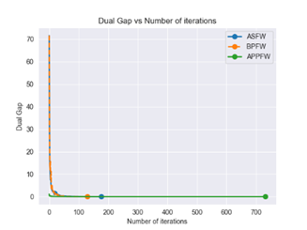
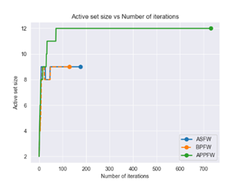
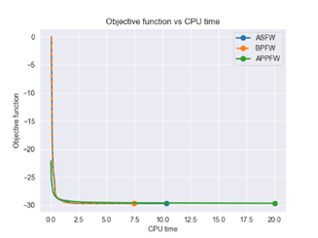
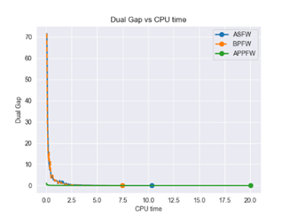
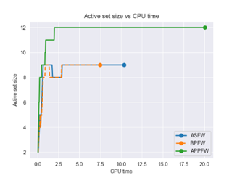
Interpretation gaussian dataset

Slide 18
Experiment breast cancer dataset

Slide 19
EXPERIMENT BREAST CANCER DATASET
TRAIN |  |  |  |  |  | TEST
 | EPSILON | ITTERATIONS | CPU TIMES (S) | RADIUS | ACTIVE SET SIZE | FN | FP | RECALL(%) | F1 SCORE (%)
ASFW | 0.1 | 64 | 26.38 | 11.077366 | 6 | 50 | 5 | 76.415 | 85.488
ASFW | 0.01 | 92 | 36.97 | 11.077386 | 6 | 50 | 5 | 76.415 | 85.488
ASFW | 0.001 | 118 | 98.634 | 11.077386 | 6 | 50 | 5 | 76.415 | 85.488
BPFW | 0.1 | 32 | 18.165 | 11.077378 | 6 | 50 | 5 | 76.415 | 85.488
BPFW | 0.01 | 50 | 24.112 | 11.077386 | 6 | 50 | 5 | 76.415 | 85.488
BPFW | 0.001 | 66 | 31.402 | 11.077386 | 6 | 50 | 5 | 76.415 | 85.488
APPFW | 0.1 | 4 | 2.004 | 11.758557 | 5 | 59 | 3 | 72.17 | 83.152
APPFW | 0.01 | 35 | 11.0 | 11.130932 | 7 | 50 | 5 | 76.415 | 85.488
APPFW | 0.001 | 608 | 146.278 | 11.080393 | 7 | 50 | 5 | 76.415 | 85.488

Slide 20
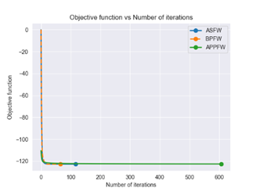
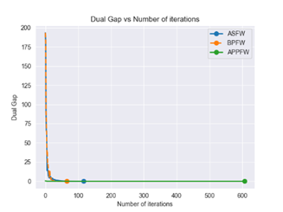
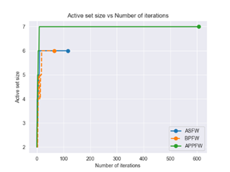
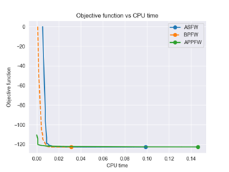
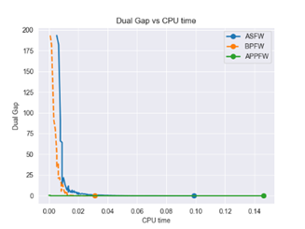
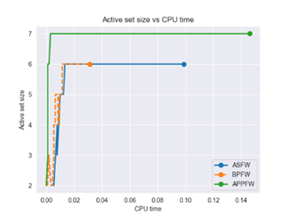
interpretation breast cancer dataset

Slide 21
Experiment customer churn dataset

Slide 22
EXPERIMENT CUSTOMER CHURN DATASET
TRAIN |  |  |  |  |  | TEST
 | EPSILON | ITTERATIONS | CPU TIMES (S) | RADIUS | ACTIVE SET SIZE | FN | FP | RECALL(%) | F1 SCORE (%)
ASFW | 0.1 | 55 | 131.633 | 6.708818 | 6 | 445 | 2 | 10.101 | 18.282
ASFW | 0.01 | 80 | 154.788 | 6.709065 | 6 | 447 | 2 | 9.697 | 17.615
ASFW | 0.001 | 100 | 217.184 | 6.709067 | 6 | 447 | 2 | 9.697 | 17.615
BPFW | 0.1 | 32 | 74.47 | 6.709004 | 6 | 448 | 3 | 9.495 | 17.248
BPFW | 0.01 | 40 | 97.306 | 6.709067 | 6 | 447 | 2 | 9.697 | 17.615
BPFW | 0.001 | 54 | 116.559 | 6.709067 | 6 | 447 | 2 | 9.697 | 17.615
APPFW | 0.1 | 3 | 5.293 | 7.184624 | 4 | 491 | 1 | 0.808 | 1.6
APPFW | 0.01 | 13 | 14.184 | 6.753838 | 6 | 454 | 1 | 8.283 | 15.27
APPFW | 0.001 | 178 | 178.887 | 6.711496 | 7 | 447 | 2 | 9.697 | 17.615

Slide 23
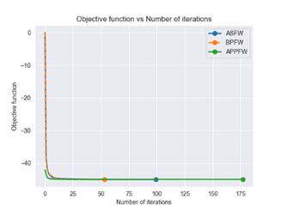
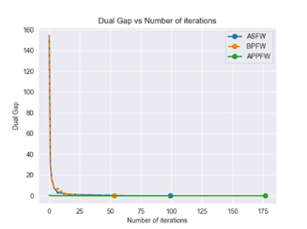
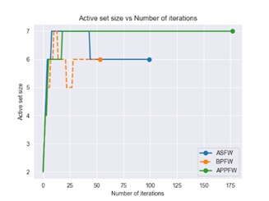
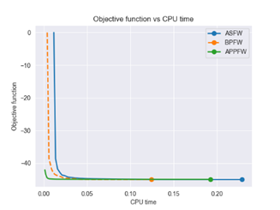
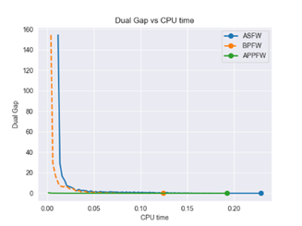
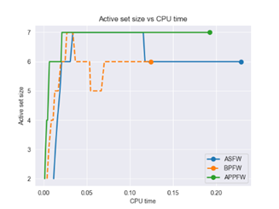
interpretation customer churn dataset

Slide 24
Growth strategy
Feb 20XX
Roll out product to high profile or top-level participants to help establish the product
Mar 20XX
Release the product to the general public and monitor press release and social media accounts
Oct 20XX
Gather feedback and adjust product design as necessary

Slide 25
conclusion
At Contoso, we believe in giving 110%. By using our next-generation data architecture, we help organizations virtually manage agile workflows. We thrive because of our market knowledge and great team behind our product. As our CEO says, "Efficiencies will come from proactively transforming how we do business.”

Slide 26
THANK YOU for your attention
You can find the project at the following link

